Slide 1

Principles of Software Development
Transforming Best Appliances
“Implementing Cutting-Edge Tech for Superior Support and Reliability”
Redge Santillan
Christian Valdez
Chioma Ukaegbu

Slide 2






Limit Business Process Disruptions
The new architecture closely follows the previous functionality to minimize disruptions to existing business processes.
Same Actors/Personas
The same actors have access to the same services and privileges, as to not change roles too much
Working UIs
The Client-facing web app, and the Expert-facing mobile app is fully functional - we will utilize this in our architecture.
Sizeable project resources
We designed our architecture based on the assumption that the project will be well-funded, enabling us to deploy resources flexibly and generously.
Best Appliances - Commitment to Excellence
Assumptions

Slide 3






User Registration and Support Plan Purchase
Customers should be able to register for support plans and purchase them through the Best Appliance website.
Problem Ticket Creation
Customers with support plans should be able to create problem tickets via the website, including necessary details about the issue.
Problem Resolution
Experts should be able to mark tickets as complete and update the knowledge base with resolution details.
Expert Assignment
The system should determine and assign the most suitable appliance expert based on skills, location, availability, and workload. Expert gets automatically
Notification (Expert & Customer)
Upon ticket assignment, the selected repair expert should be notified via text message, and the customer should receive notification based on their preferred communication channel (email or SMS).
Mobile Access for Experts
Repair experts should be able to access ticket information, customer location, and a knowledge base through a mobile application.
Customer Feedback
After ticket completion, the system should send a survey link to the customer for feedback.
Best Appliances - Commitment to Excellence
Functional Requirements

Slide 4
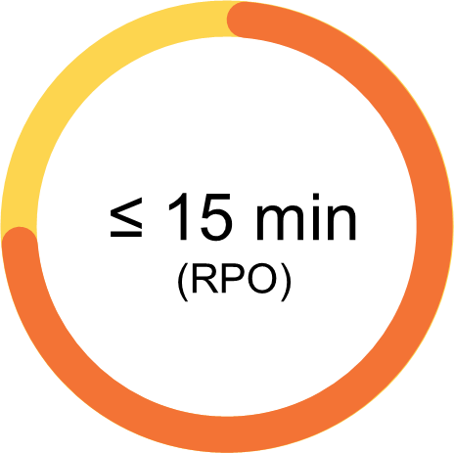
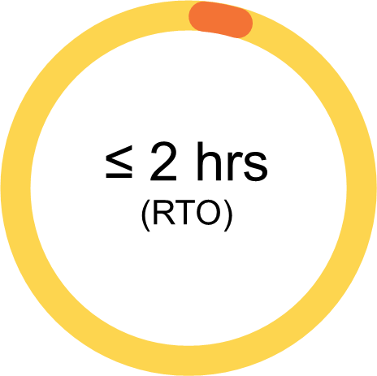
Performance
Response Time: ≤ 2 sec for web, ≤ 500 ms for API
Throughput: ≥ 1000 ticket requests/min at peak
Efficiency: Resource use ≤ 70% under normal load
Reliability & Availability
Uptime: 99.9% (excluding maintenance)
Failover: ≤ 30 sec
Data Accuracy: Error rate < 0.01%
Scalability
Horizontal Scalability: Handle 2x peak load
Load Balancing: ≤ 5% variance between instances
Security
Data Encryption: Secure both in transit and at rest
Maintainability & Supportability
Deployment Downtime: < 1 min
Bug Resolution: < 24 hrs for critical, < 72 hrs for others
Documentation: Updated quarterly
Testing: 90-95% code coverage for new features pre-staging merge
Best Appliances - Commitment to Excellence
Non-functional Requirements

Slide 5

Knowledge Base and Support Content
Original System: Embedded as part of the main application.
New System: A standalone Knowledge Base microservice with its own search and update capabilities.
Billing and Payment Processing
Original System: Tightly coupled with customer profiles.
New System: A separate Billing Service that interacts with Customer Profiles via events, allowing independent updates and scaling.
Notification System
Original System: Integrated notification logic.
New System: A dedicated Notification Service that subscribes to relevant events across services to send emails and SMS messages.
User and Access Management
Original System: A single module may handle all types of user data.
New System: Separate microservices for customer management, expert management, and internal user management.
Ticket Management
Original System: One component handles ticket creation, assignment, tracking, and completion.
New System: Distinct microservices for ticket creation, expert assignment, and ticket lifecycle management. Each has its own database.
Best Appliances - Commitment to Excellence
Coupling

Slide 6
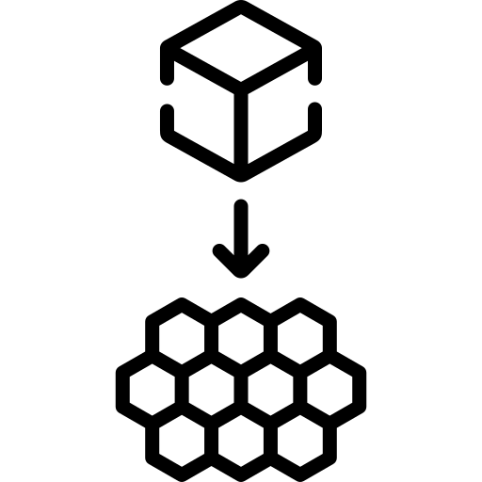
Microservices:
User Management Service
Billing Service
Customer Survey Service
Payment History
Best Appliances - Commitment to Excellence
Microservices-1

Slide 7
Assignment & Routing Service: Ticket Assignment, Ticket Routing
Ticket Management Service: Ticket Creation, Ticket Completion
Expert Management Service: Admin Login. Expert Profile
Knowledge Base Service: Search KB, Retrieve KB, Add KB
Notification Service: Customer Notification, Customer Survey
Customer Management Service: Customer Profile, Customer Login, Customer UI
Best Appliances - Commitment to Excellence
Microservices-2

Slide 8
Ease for Upgrades and Patching: Microservices can be upgraded or patched independently, reducing downtime and risk.
Elasticity: Each microservice can scale in or out independently, based on demand, improving resource utilization.
Fault Tolerance: The failure of one microservice doesn’t affect others. Event-driven systems can queue messages until the service is restored.
Performance: Microservices allow for distributed processing, which can enhance performance, especially when paired with caching and optimized databases
Reliability: Each service is isolated, reducing the chances of a cascading failure. Reliable event mediators and brokers ensure event delivery.
Testability: Smaller, decoupled services are easier to test in isolation.
Best Appliances - Commitment to Excellence
Software Architecture Characteristics

Slide 9
strict
loose
Billing
Contract: Strict
Data: JSON, XML Schema
Transactions: ACID
User Management Service
Contract: Strict
Data: JSON
Transactions: ACID
Roles: Customer, Expert,
Admin/Manager
Survey Service
Contract: Moderate
Data: Simple JSON
Transactions: BASE
Ticket Management
Contract: Loose
Data: JSON
Transactions: BASE
Customer Management
Contract: Strict
Data: JSON
Transactions: ACID
Assignment & Routing
Contract: Loose
Data: KVP (maps) in JSON
Transactions: BASE
Expert Management
Contract: Strict
Data: JSON, RPC
Transactions: ACID
Knowledge Base Service
Contract: Loose
Data: GraphQL, JSON
Transactions: BASE
Notification Service
Contract: Strict
Data: JSON, XML Schema
Transactions: BASE
Best Appliances - Commitment to Excellence
Strict/Loose Contracts

Slide 10
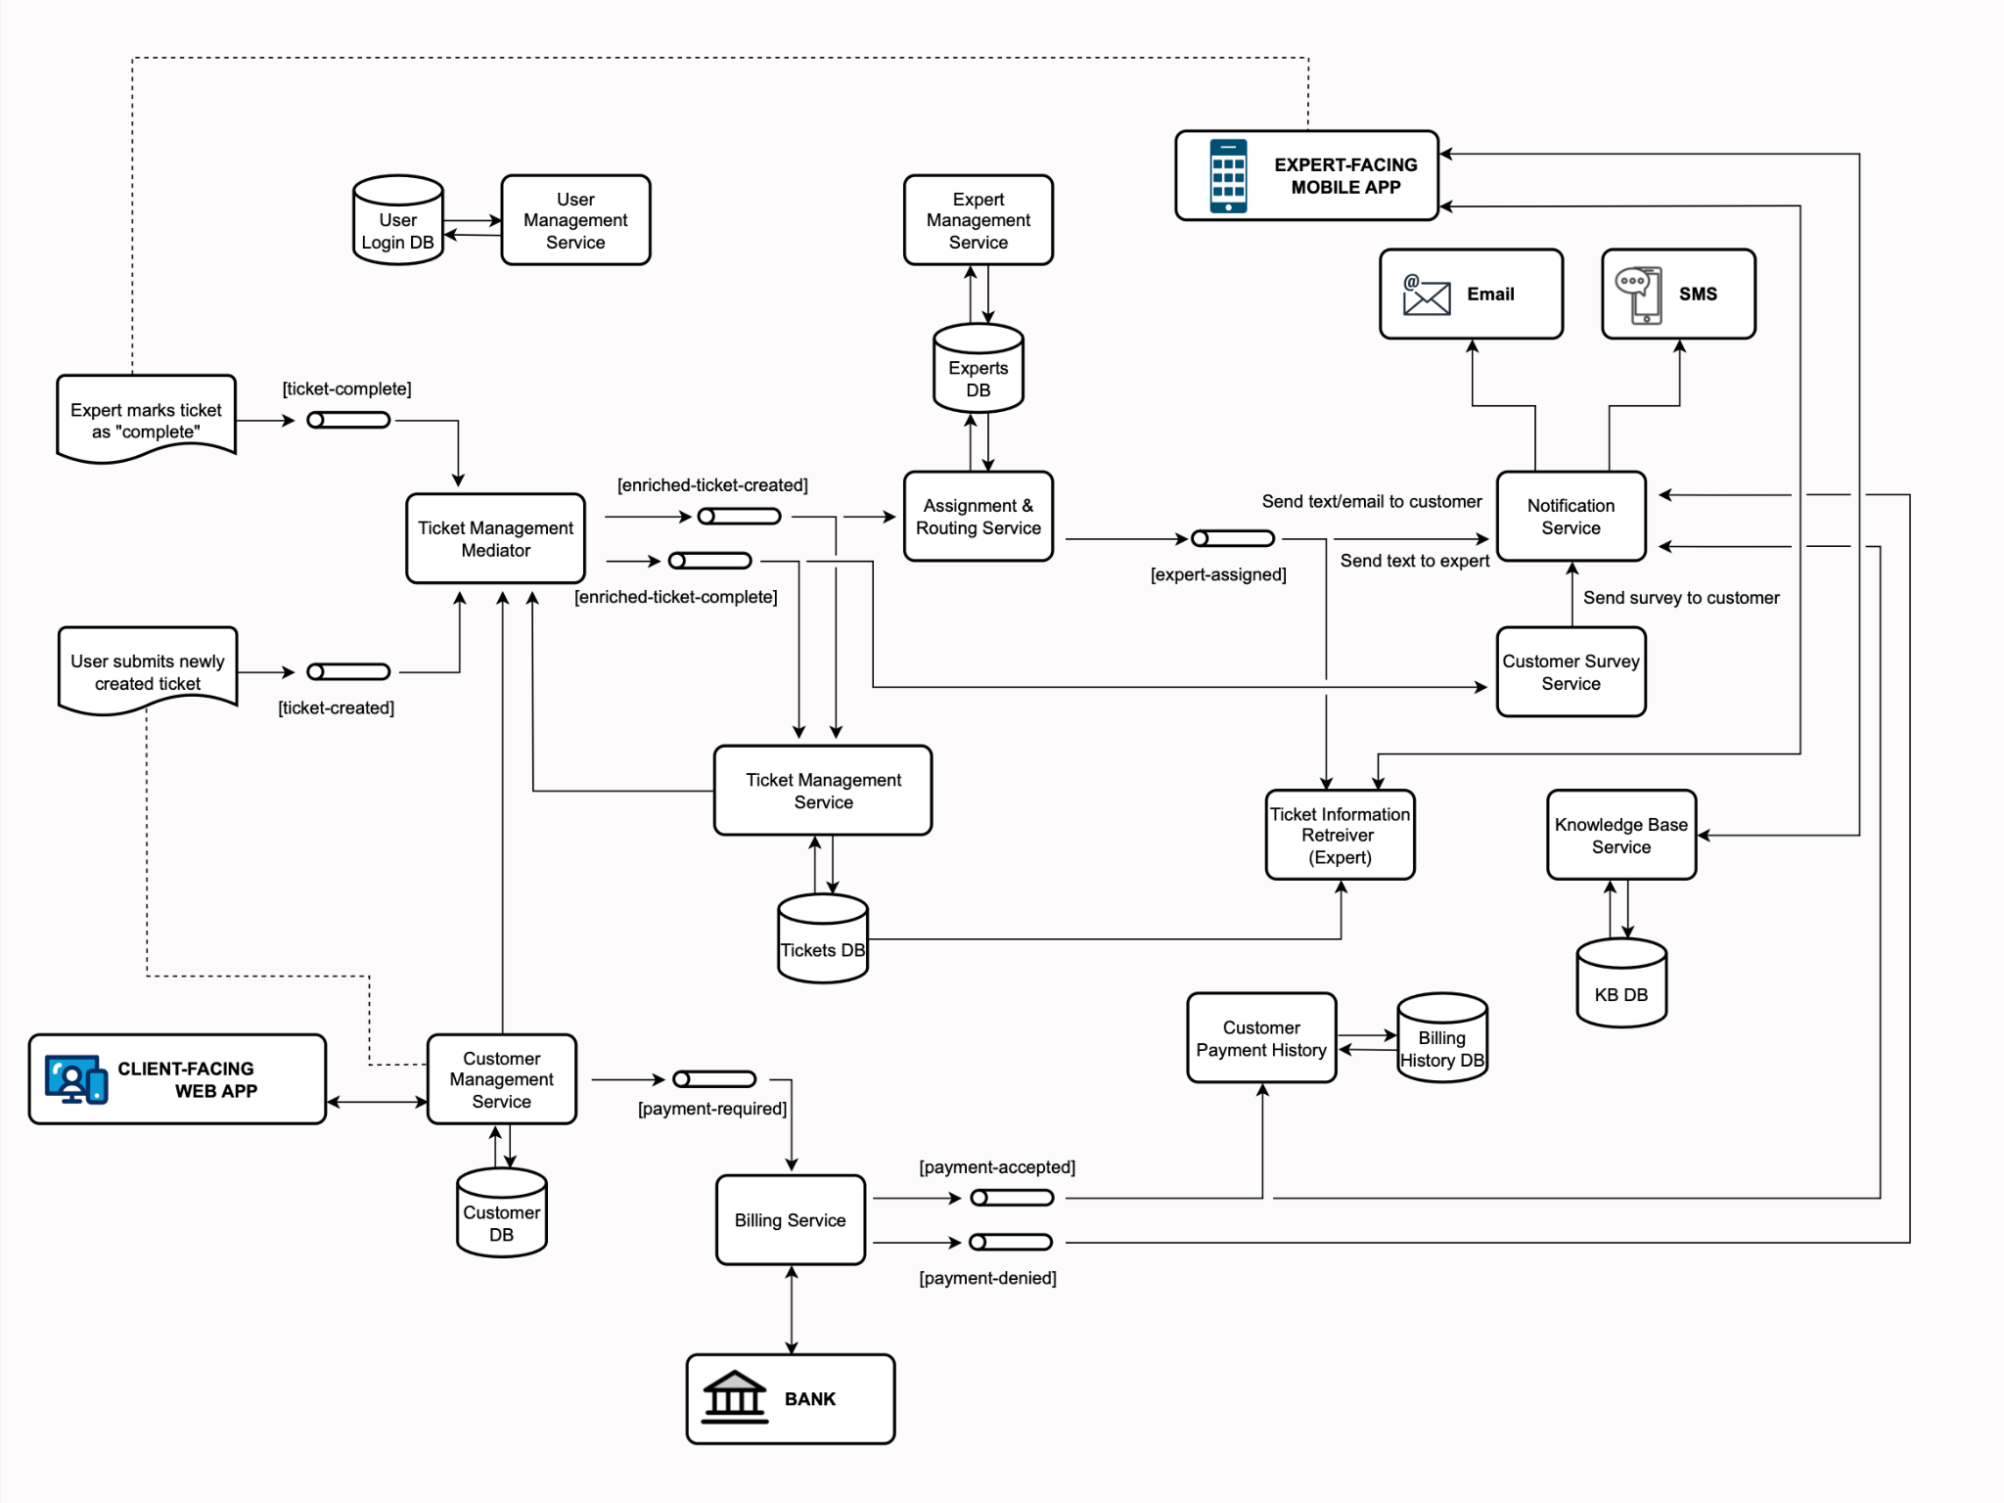
Best Appliances - Commitment to Excellence
Software Architecture

Slide 11
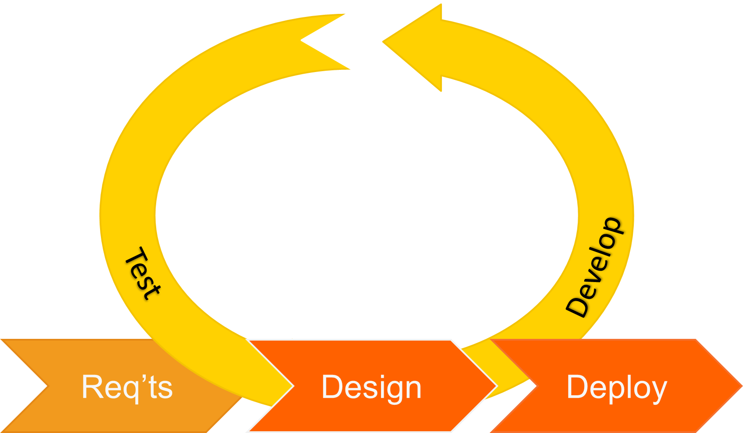
UAT
Mirror production data
Verify RTM
Final sprint retrospective
CAB approval
QA Environment
“CD” to QA environment
Assess integration
Run system tests
Log bugs
PROD Environment
Setup Blue and Green environments
Gradual switch
Ensures zero downtime Facilitate rollback
DEV Environment
Scrum meetings
Sprint plannings
Unit testing
“CI” and regular commit
Post-Deployment
Continuous monitoring
Gather use stories
Continuous updates and improvement
Best Appliances - Commitment to Excellence
Agile Development

Slide 12
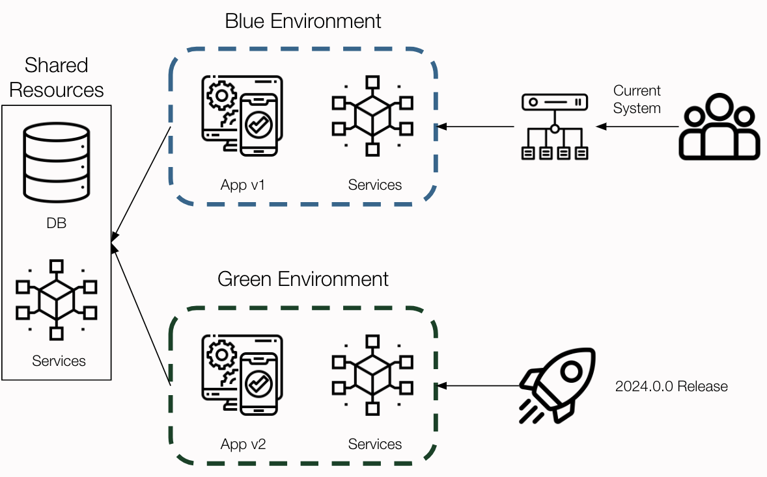
Preparation
Set up Blue and Green environments.
Conduct extensive testing on the Green environment.
Deployment
Direct traffic to the Blue
Prepare load balancer or DNS for traffic switching.
Synchronize data from Blue to Green before the switch.
Rollback Strategy
Immediately redirect traffic back to Blue.
Reconcile data changes between Green and Blue.
Analyze and fix issues in Green before retrying.
Post-Deployment
Evaluate Green's performance; clean up and prepare Blue for standby.
Collect feedback for deployment process improvement.
Advantages
No downtime during the switch.
Low risk with immediate fallback option.
Transparent to users.
Best Appliances - Commitment to Excellence
Deployment Strategy

Slide 13

Performance Metrics
Response Time (Web ≤ 2 sec, API ≤ 500 ms)
Throughput (≥ 1000 ticket requests/min)
Resource Efficiency (≤ 70% resource utilization)
Reliability & Availability
System Uptime (Target: 99.9%)
Failover Time (Goal: ≤ 30 sec)
Data Accuracy
Error Rate (Target: < 0.01%)
Scalability
Load Handling (Capability: 2x peak load)
Load Balancing (Variance: ≤ 5% between instances)
Quality Assurance
Code Coverage (90-95%)
System Performance
Latency and Response Times
Server/App Performance
Uptime/Downtime Records
Failover Process Effectiveness
User and Traffic Patterns
User Traffic and Behaviour Analytics
Security Monitoring
Security Monitoring
Access Logs & Breach Attempts
Compliance with Security Policies
System Health & Diagnostics
Error Rates & Exceptions
Automated Alerts & Notifications
Customer Feedback
Customer Satisfaction Metrics
Best Appliances - Commitment to Excellence
Fitness Function

